Slide 1
Rain Prediction –Weather forecasting

Slide 2
About the dataset
Rain Dataset is to predict whether or not it will rain tomorrow. The Dataset contains about 10 years of daily weather observations of different locations in Australia.

Slide 3
Predict the temperature using Different Algorithms
To predict the temperature using Different Algorithms ML Algorithms: Linear Regression, Decision Tree Regression
Algorithm - Decision Tree: builds regression or classification models in the form of a tree structure Algorithm - Linear Regression: performs the task to predict a dependent variable value (y) based on a given independent variable (x)

Slide 4
Data preprocessing
the data can also be used to make visualization which would help to understand the impact of global warming over the various aspects of the weather like precipitation, humidity, temperature, etc.
Check for null values using isnull() function,
Replace the null values with fillna() method.
Fetching data description using describe()method.
Convert categorical columns to numerical values using labelencoder.

Slide 5
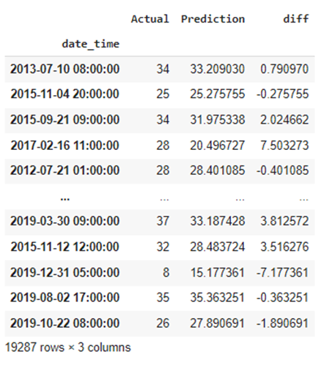
Multiple Linear Regression:
This regression model has high mean absolute error, hence turned out to be the least accurate model. Given below is a snapshot of the actual result from the project implementation of multiple linear regression.

Slide 6
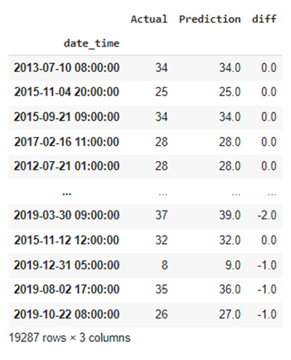
Decision Tree Regression: .
This regression model has medium mean absolute error, hence turned out to be the little accurate model. Given below is a snapshot of the actual result from the project implementation of multiple linear regression

Slide 7
Evaluation
0.21539317507418398
0.21539317507418398
R2-score for Multiple Linear Regression
score=r2_score( y_test,prediction)
0.16209268227508977
R2-score for Decision Tree Regression
0.21539317507418398

